Slide 1
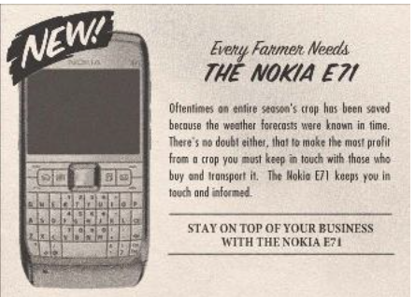
The fall of Nokia mobile
By Aditya Mengani
Intended Audience: Managers attending a seminar on industry disruptions and its impacts
Tuesday 4 pm, 30-June-2020
Notes:
> Today I am going to discuss about the fall of Nokia
> Intended audience are Managers attending a seminar on industry disruptions and its impacts

Slide 2
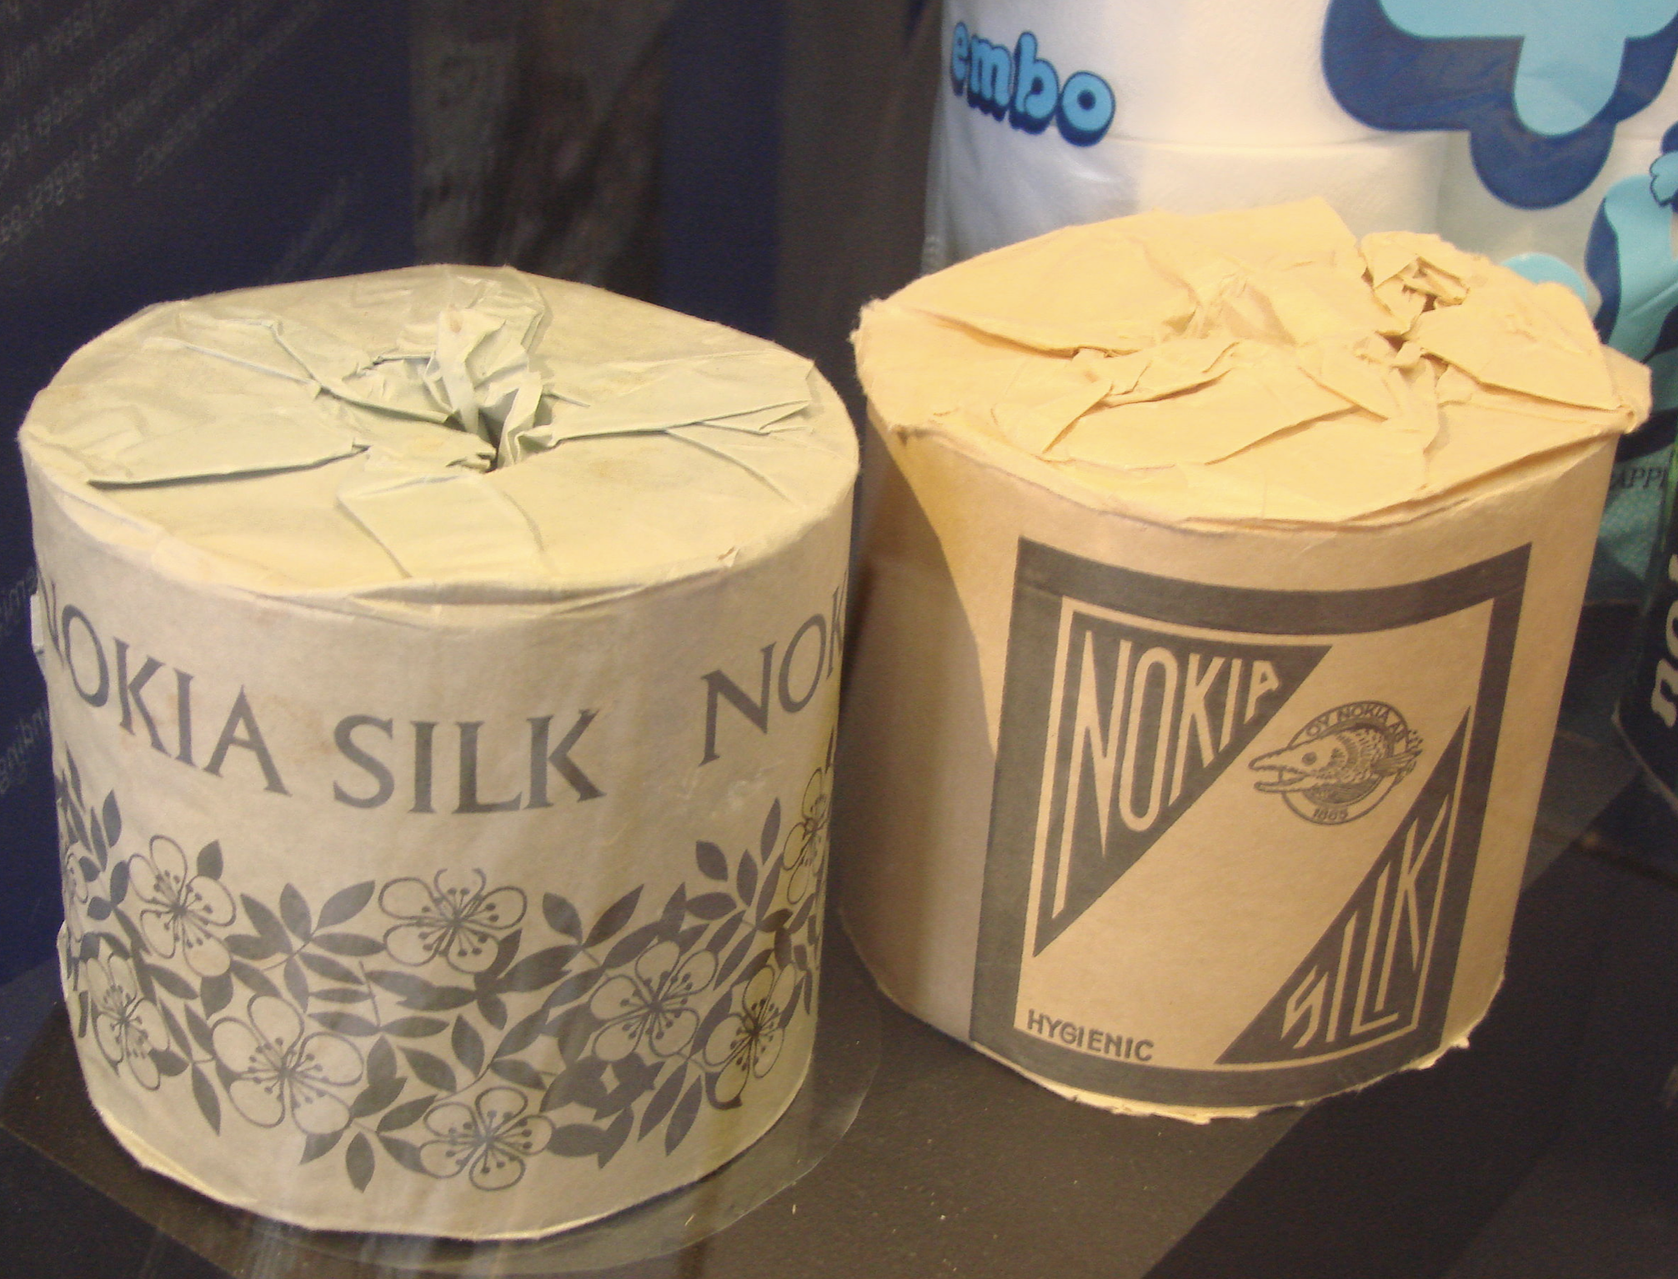
Once upon a time...
Notes:
> Once upon a time
> Nokia , a finnish MNC was found in 1865
> It was named after a small town named Nokia in Finland
> Started as a pulp manufacturer

Slide 3
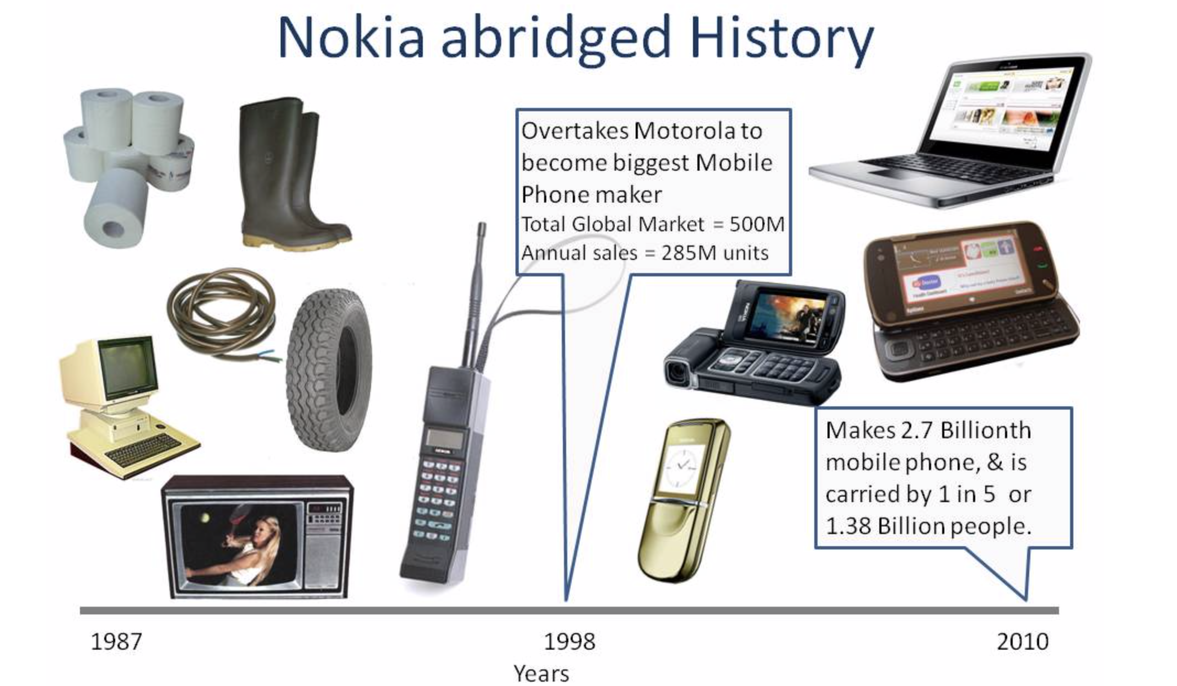
And every day ...
Notes:
> In mid-late 20th century diversified into 4 major businesses: forestry, cable, rubber and electronics
> In late 20th century it started acquiring many companies related to manufacturing mobile and computers
> It strategized itself to be a major telecom manufacturer and focused on mobile and telecom manufacturing
> These ventures led to a huge success and then it later started “Symbian” an inhouse operating system for its mobiles
> By early 2000, it became the largest manufacturer of mobile phones in the world and maintained its dominance in the next couple of years

Slide 4
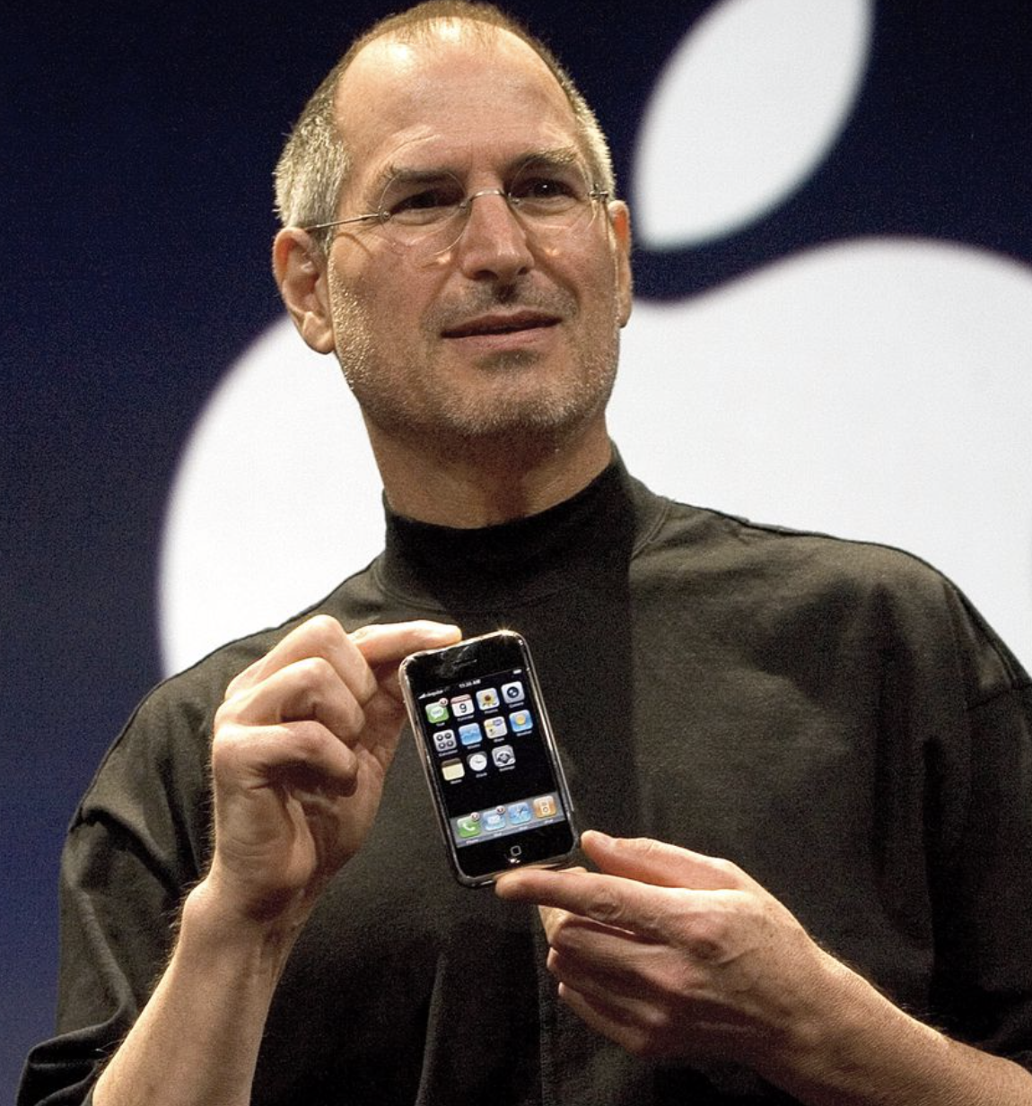

Until one day ...
Notes:
> On June 29, 2007 Steve Jobs released the 1st generation iphone and iOS. This started a major disruption in mobile device industry
> Soon after another wave of disruption came from open source platform Android, when it released Gingerbread in 2010
> These two mobile platforms created a huge makeshift in the mobile industry in the following years to come

Slide 5
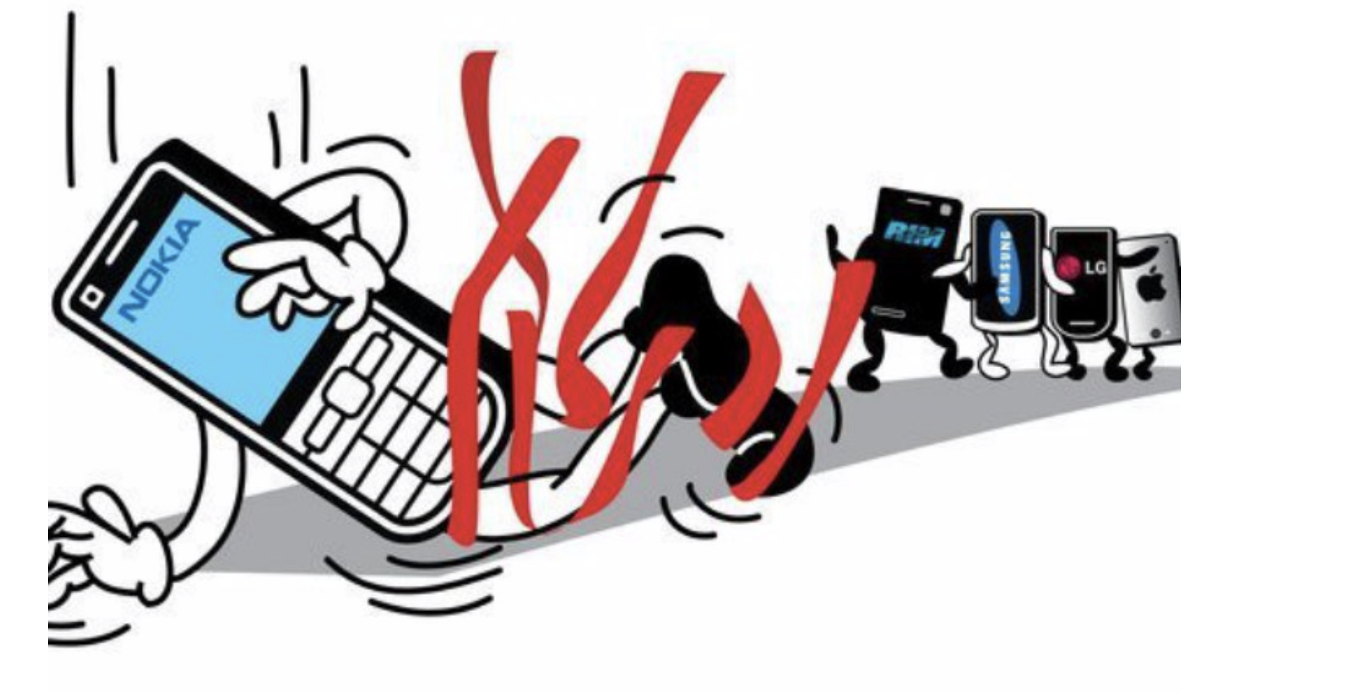
And because of this
Notes:
> This led to the start of Nokia’s downfall
> There is no one reason for the downfall
> Lack of robustness in its symbian platform
>Ignoring the next wave of smart phone/touch screen devices
>Combined with advanced features on iOS and Android platforms caused huge havoc for Nokia

Slide 6
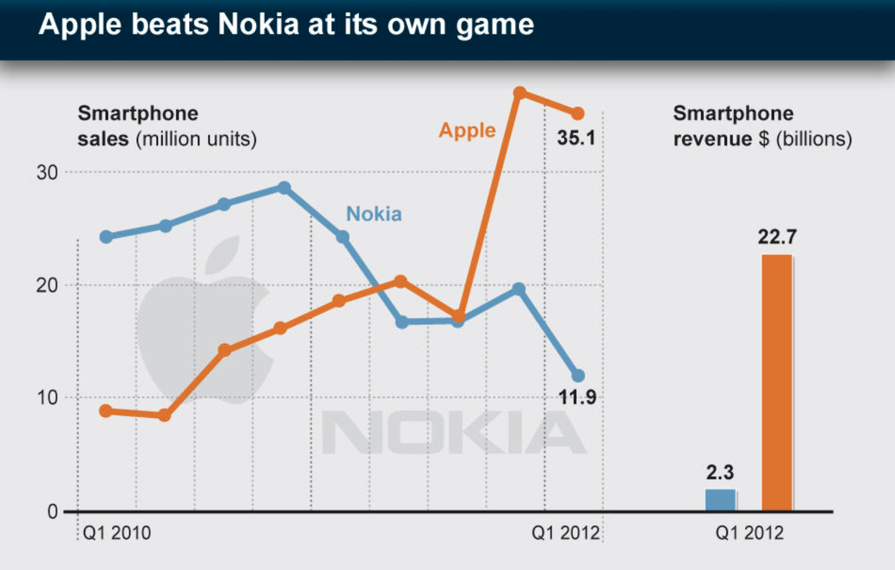
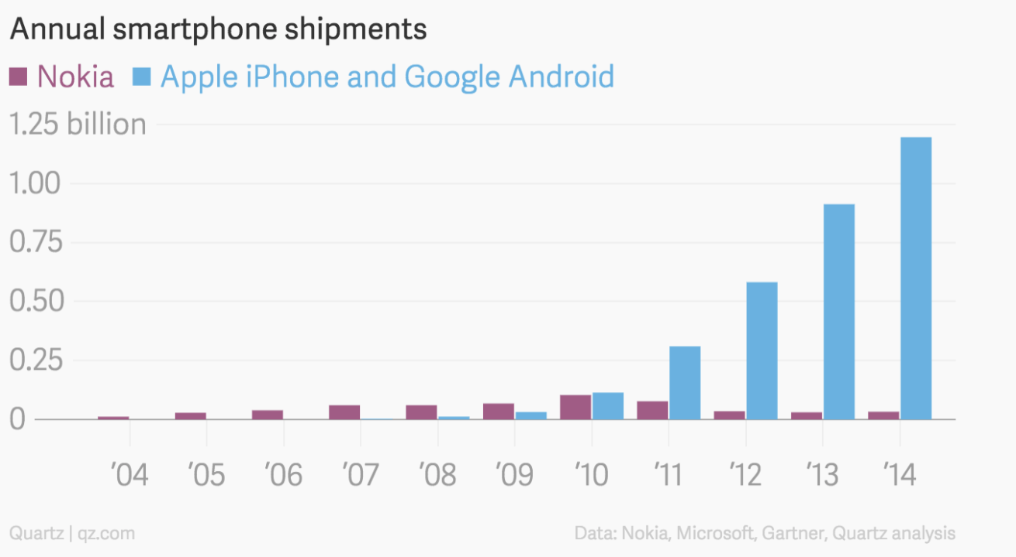
And because of this
Notes:
> The sales of Nokia phones started to go south
> The rise of iOS and Android was inversely proportional to that of fall of Nokia
> Nokia was late to identify these disruptions and adapt to them and was left behind

Slide 7
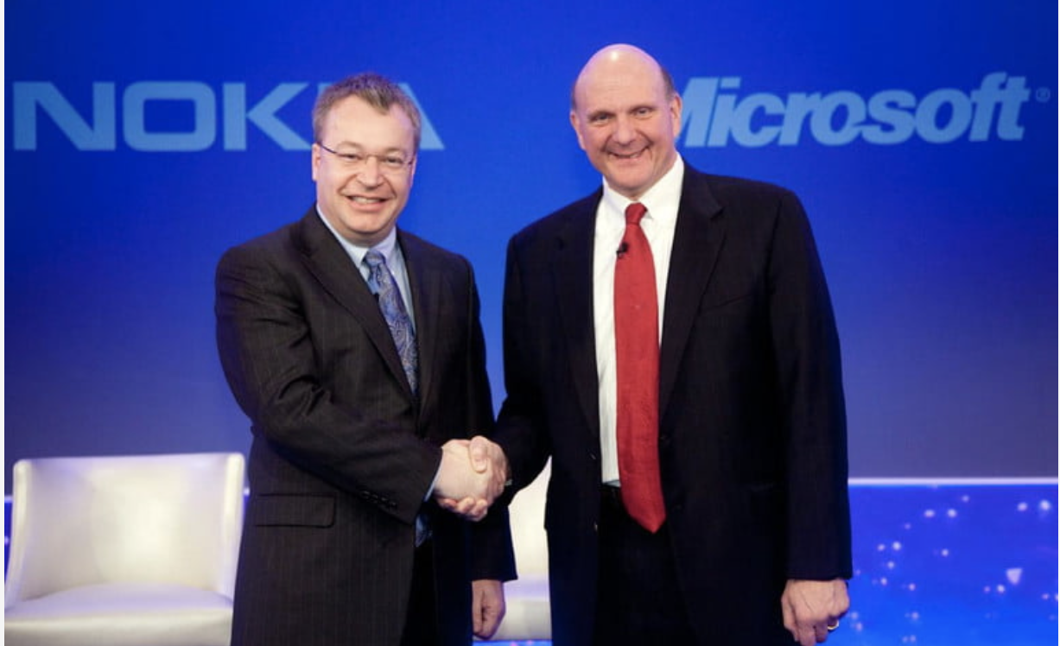
Until finally...
Notes:
> It saw an opportunity to bounce back when Microsoft purchased its mobile division
> This proved to be of no luck for the big old mobile device manufacturer
> The idea of Hardware from Nokia and Software from Microsoft seemed great on paper, but it was soon realized to be futile
> Moreover Bureaucracy in the firm meant it suppressed the innovative minds and led to many of its employees leave

Slide 8
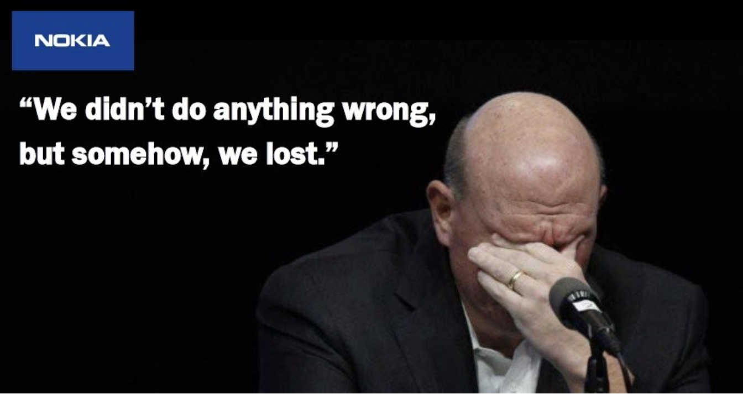
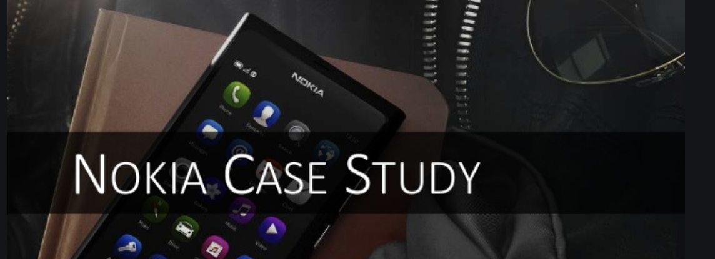
and ever since that day ...
Notes:
> Soon this led to one of the biggest disasters for Microsoft
> Microsoft realized that this model is not profitable and eventually had to write off Nokia purchase
> The company was later sold to HMD global for a loss
> And ever since that day, Nokia became a case study at many schools, and pushed companies like Microsoft to relook into their work culture and innovation

Slide 9
Moral of the Story : It is not only what we do, but also what we do not do, for which we are accountable - Moli’ere
Questions?? Thank you !!

Slide 10
References
https://medium.com/multiplier-magazine/why-did-nokia-fail-81110d981787
https://www.zdnet.com/article/nokia-reinvented-decline-resurrection-and-how-ceos-get-trapped/
5-big-barriers-that-will-prevent-nokia-from-becoming-the-market-leader-again
https://mhealthinsight.com/2010/01/05/2000-2009-the-nokia-decade-but-why-should-it-stop-there/
https://mhealthinsight.com/2010/01/05/2000-2009-the-nokia-decade-but-why-should-it-stop-there/
https://news.microsoft.com/announcement/satya-nadella-named-ceo/
https://www.zdnet.com/article/nokia-reinvented-decline-resurrection-and-how-ceos-get-trapped/
https://www.slideshare.net/mnsambit/nokia-case-study-52866723

